Slide 1
Vetri cinemas food prototype
Old Date:20.10.22
Upadated date:30.10.22

Slide 2
Problem statement:
To design an application for ordering food items in a cinema theater .

Slide 3
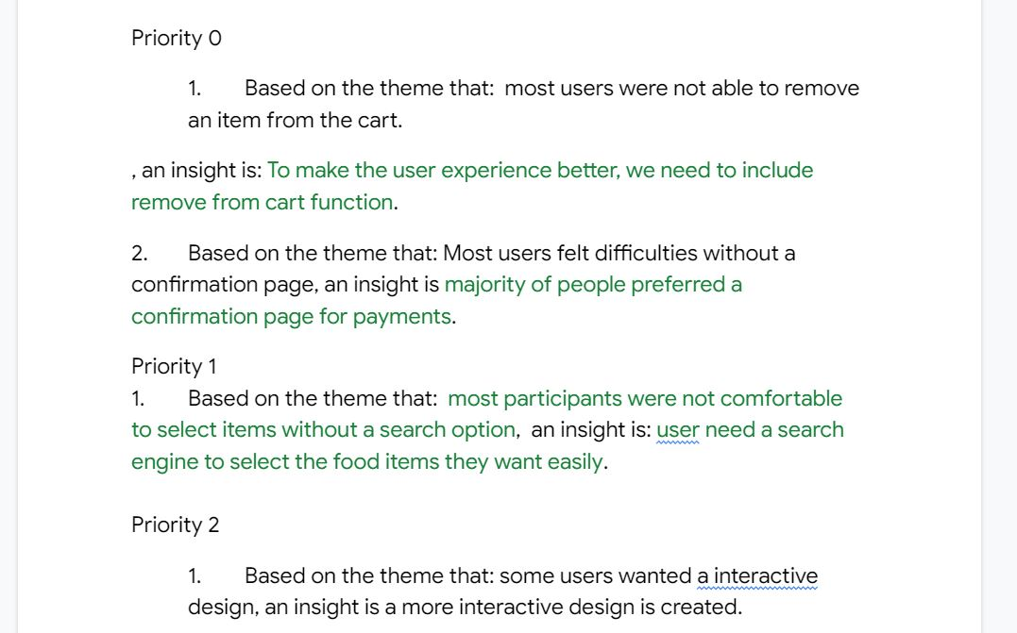
priority

Slide 4
PREVIOUS REVIEW:
Based on the previous reviews collected from the different users it is found that:
Users are satisfied with the design but further improvement will be beneficiary.
Users wanted a confirmation page for payments.
Users wanted an option of removing items from the cart.
Users were quite satisfied with the add to cart feature.
Users wanted further improvements in the overall functioning of applications.
More pages must be added to the project . This will improve overall user experience.

Slide 5
Methodology of research
Datas were collected from research through a usability study.
5 users were asked to do a series of tasks and based on their reactions and reviews , Themes were drawn.
Themes were drawn using a affinity diagram.
From the theme , Insights were drawn and necessary changes were made .

Slide 6
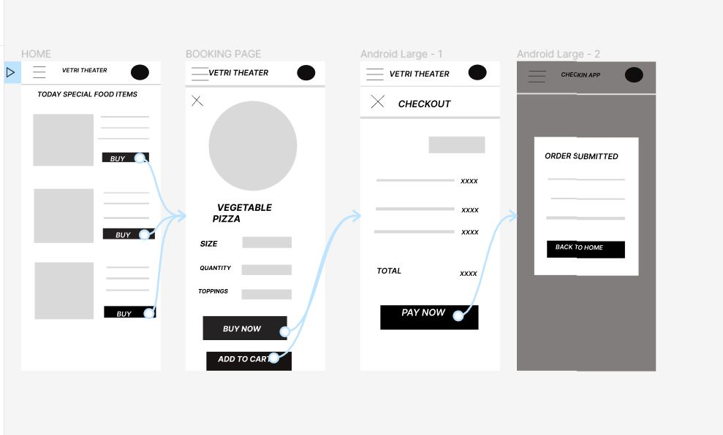
before
These are before images of my prototype

Slide 7
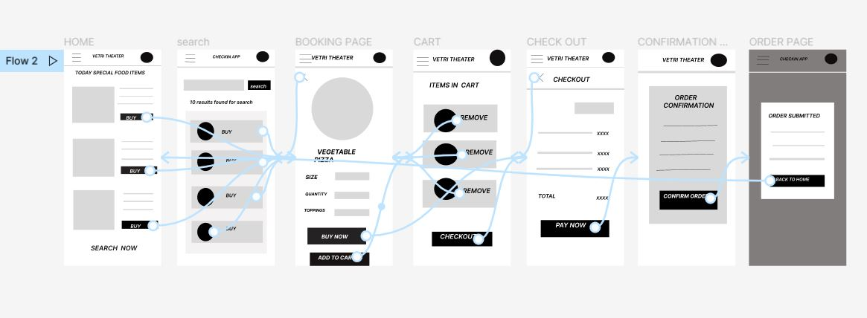
after
These are after images of my prototype

Slide 8
I have added more screens and some features based on the insights

Slide 9
RECOMMENDATIONS FOR ADDITIONAL RESEARCH
Usability study must be conducted for more users.
So that more accurate conclusions could be drawn due to diversity of users.
Usability study must be conducted for people with disabilities after assistive features are added.

Slide 10
planned next steps
More interactive features are to be added to make the user experience more enjoyable
Assistive technology are to be included to enhance the overall experience of people with disabilities.
The assistive technologies include: Screen readers, a voice over to guide the users in the process and a feature of making orders through voice without having to click or swipe. This will help people with hand related disabilities.

Slide 11
THANK YOU

